Slide 1
Stat 451 Final Project
Maya, Grace D, Meg, Grace S, Sowmya

Slide 2

Loan Approval Project
Question(s):
How can we classify whether a person will pay back their loan based on various features like FICO score, debt-to-income ratio, and interest rate?
What features are important in determining whether a person will pay back their loan?
Notes:
Will a borrower repay their loan in full?
Lenders earn money from people who repay their loans, but lose money from people who do not repay their entire loan. So our goal will be to predict, with as much accuracy as possible, whether someone will repay their loan based on a range of variables. In application, this model could help determine whether or not a person’s loan application should be approved or denied.

Slide 3
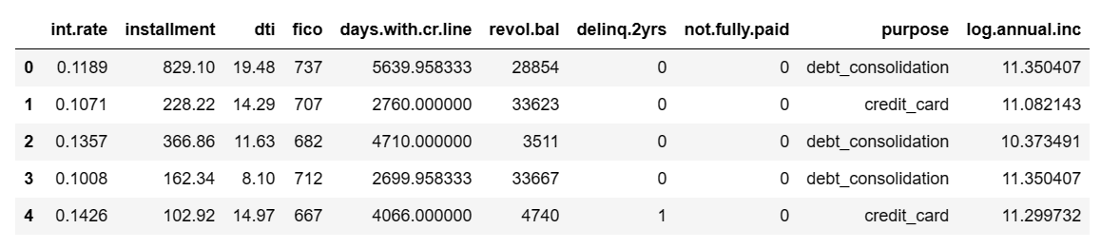
Kaggle lending dataset(2007-2010)
Variable we are predicting
Notes:
The dataset has lending data from 2007-2010 and includes 14 variables, but we will be using a subset of those variables for our purposes.
We will be predicting the not.fully.paid variable based on the variables int.rate, installment, dti, fico, days.with.cr.line, revol.bal, and delinq.2yrs, log.annual.inc, and purpose.
Different purposes of loans include 'debt_consolidation', 'credit_card', 'all_other', 'home_improvement', 'small_business', 'major_purchase', and education.

Slide 4
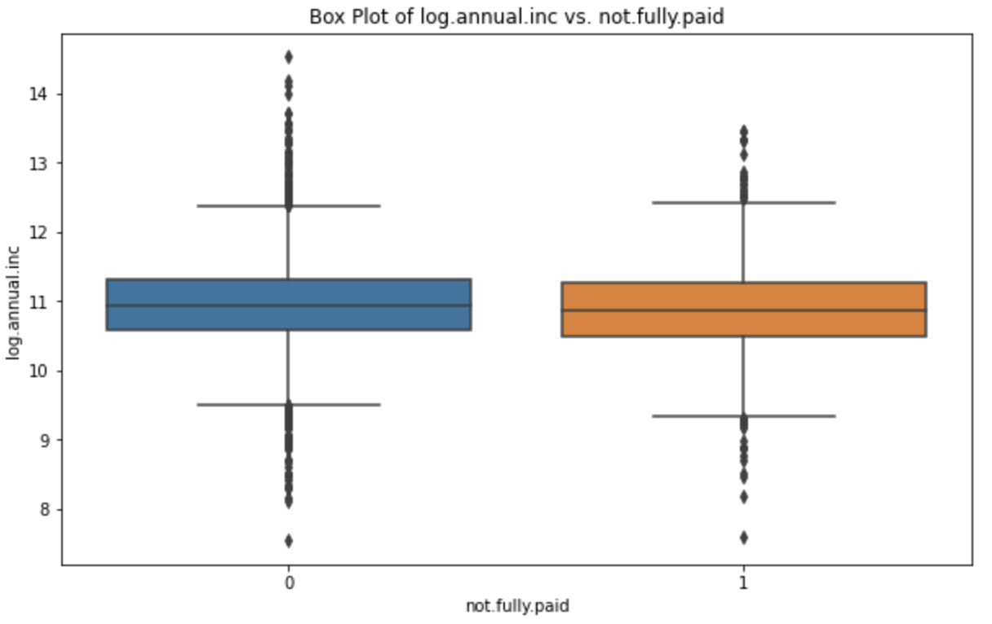
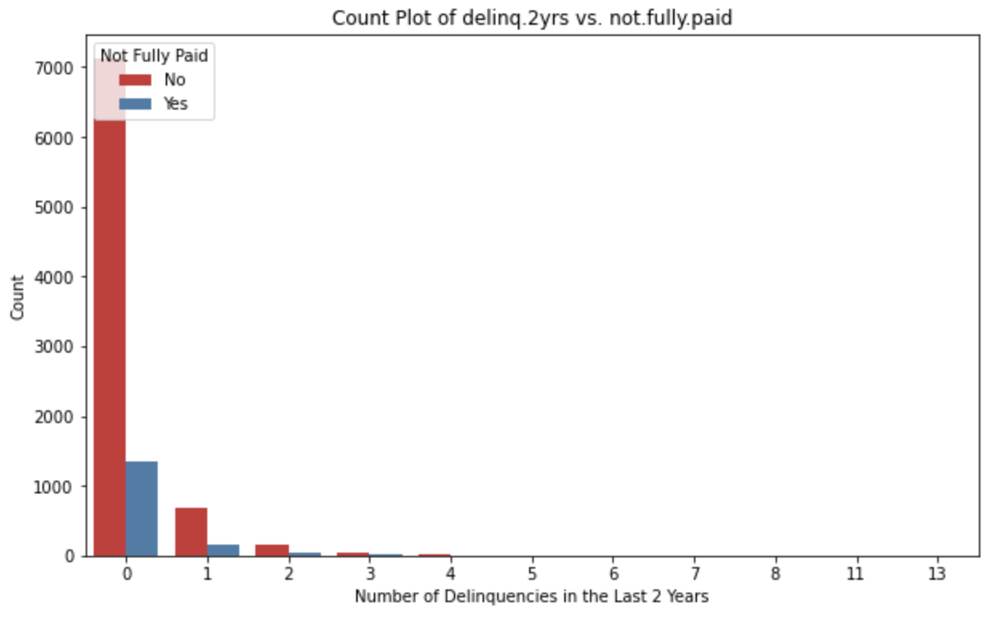
Data Exploration: Annual Income and Delinquency

Slide 5
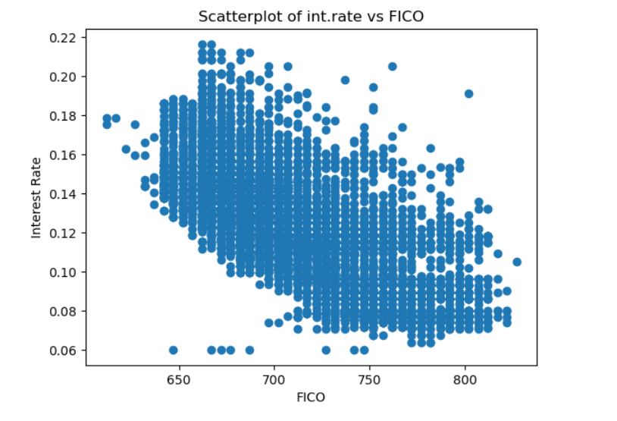
Data Exploration
Notes:
Don’t know how meaningful this interest rate graph is.

Slide 6
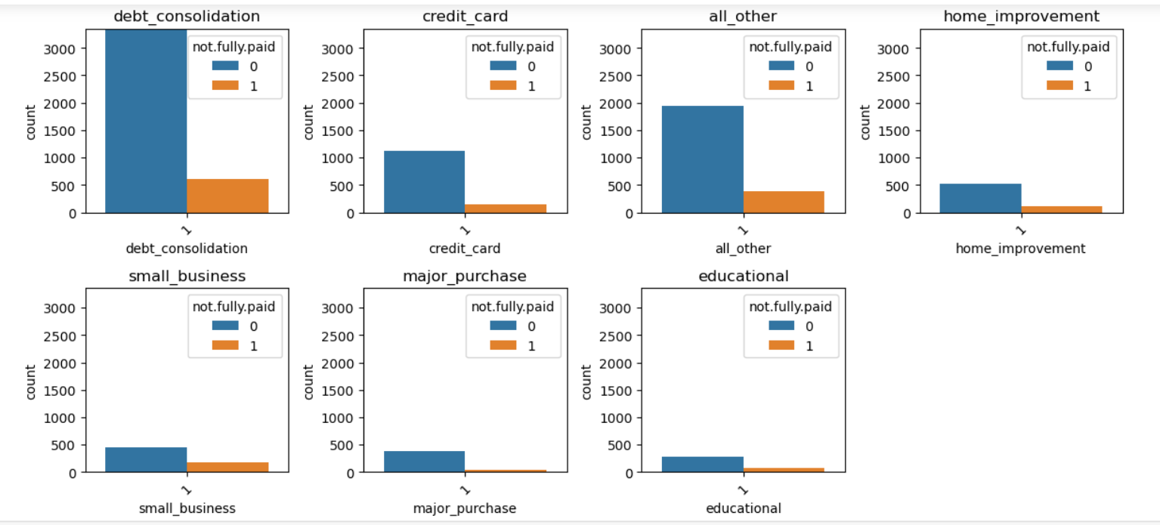
Loan Purposes

Slide 7
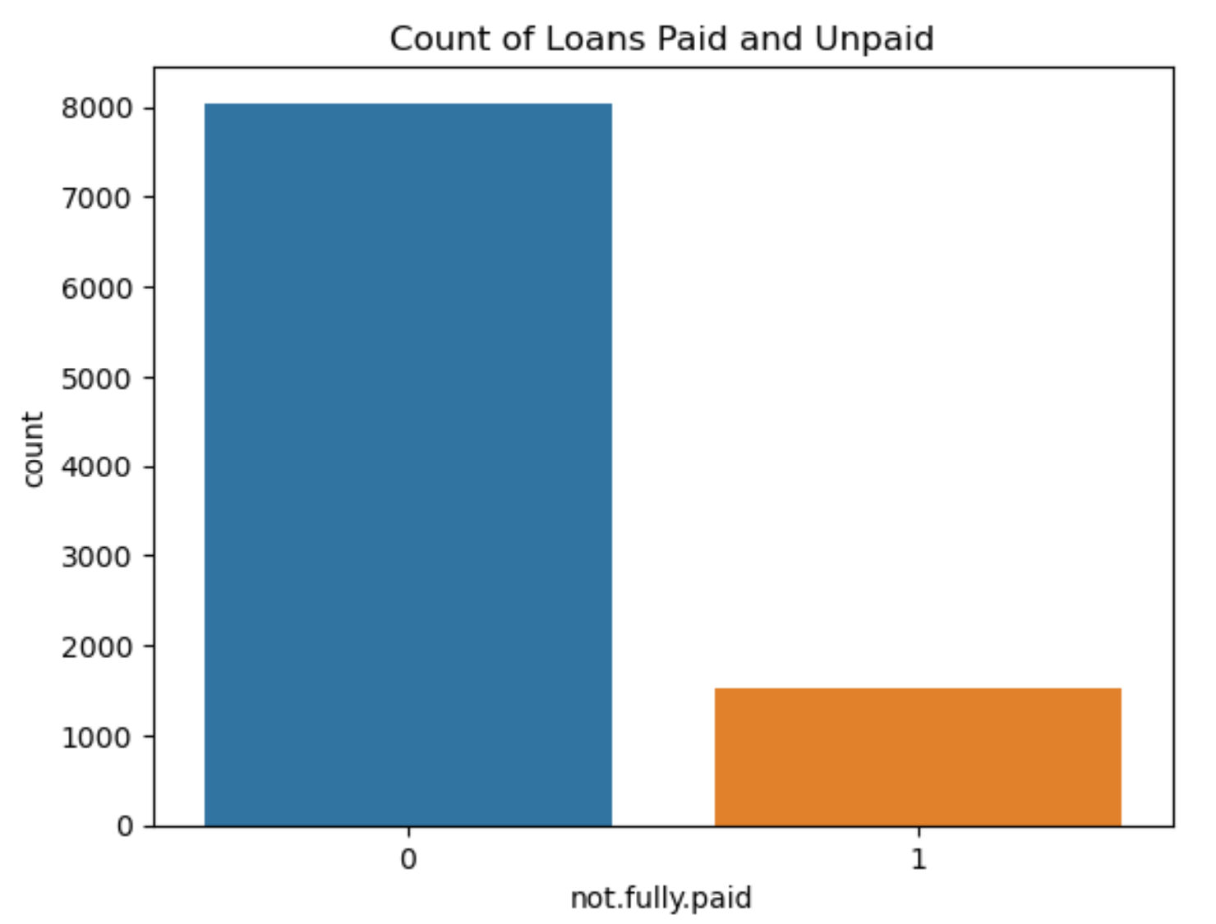
Paid vs. Unpaid Loans
83.99% of the loans from our data were fully paid back
Guessing “0” every time yields an 83.99% accuracy rate

Slide 8
Feature Engineering
Used One Hot Encoding to transform the purpose variable
Used min-max normalization (for KNN classification)
Tried to use feature selection with SelectKBest and f_classif to reduce overfitting(did not keep this as this came at the cost of a low accuracy)

Slide 9
Simple Model DecisionTreeClassifier()
Accuracy score of training data: 1
Accuracy score of validation data: 0.7537
Overfitting because training score > validation score

Slide 10
Methods
Used hyperparameter tuning to find the best classifier/parameter pairing(s)
Added higher weights to the 1 class (did not use this as it made accuracy worse)
Varied log regression decision threshold(did not use this as it made accuracy worse)

Slide 11
Outcomes: Best classifiers and parameters
Logistic Regression
parameters of C = .01, 10, 1000 all yielded the same accuracy
Decision Tree Classifier
parameters of criterion entropy with max depth 1 and 2 yielded the same accuracy
Random Forest Classifier
parameter of max_depth = 11
The best accuracy score on validation data through hyperparameter tuning was 0.83925
Notes:
No overfitting

Slide 12
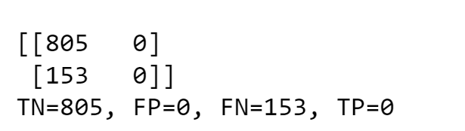
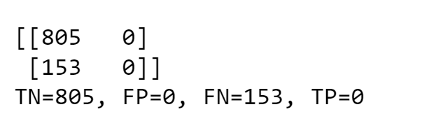
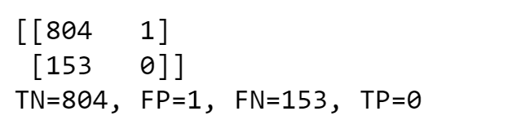
Scores for Different Models on Test Data
Decision Tree
accuracy = 0.8403
Log Regression
accuracy = 0.8403
Random Forest
accuracy = 0.8392
Notes:
Talk on this:
precision recall
0 0.84 1.00

Slide 13
Assessing Model
Used feature importance/analysis to find the most useful variables
Lasso
Impurity based vs Permutation importance
Checked for collinearity

Slide 14
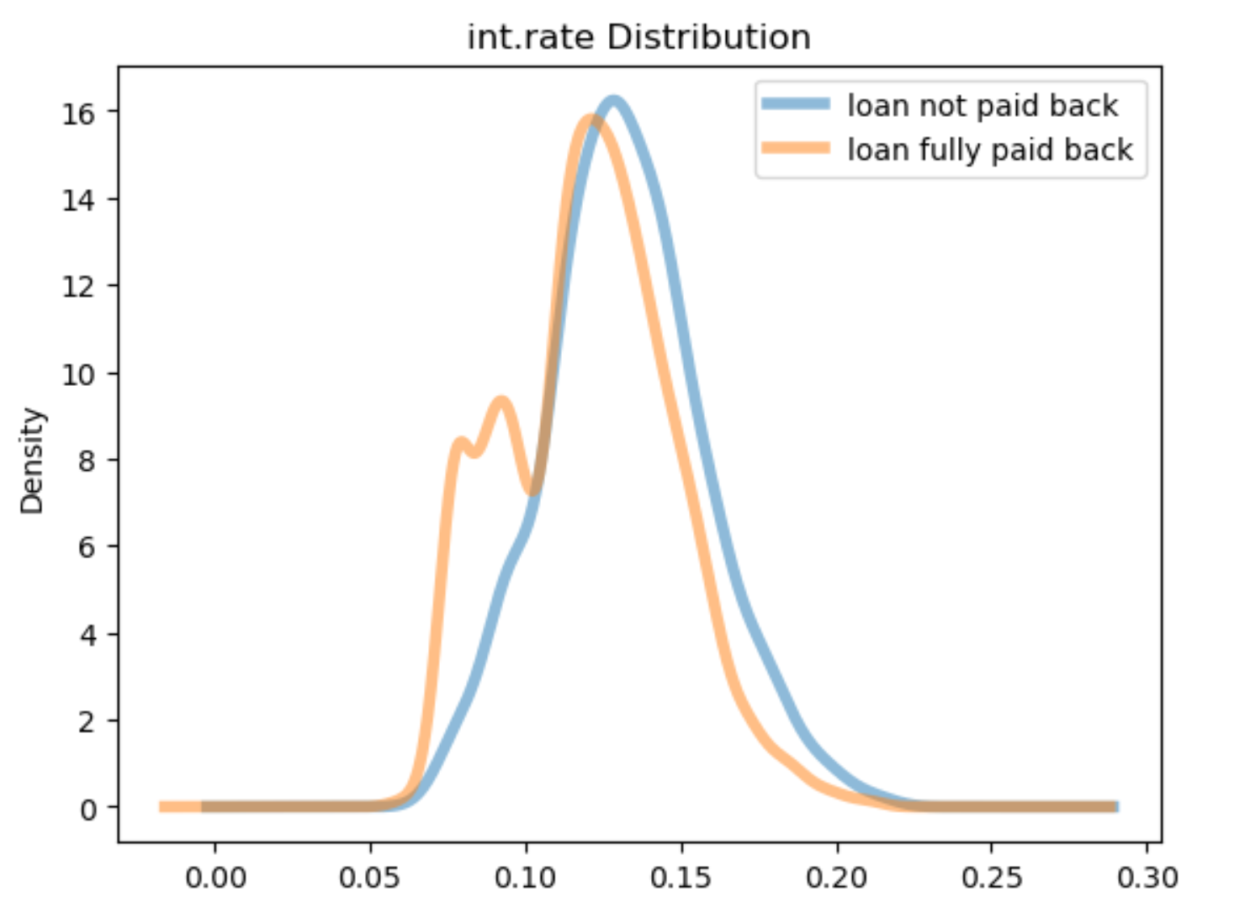
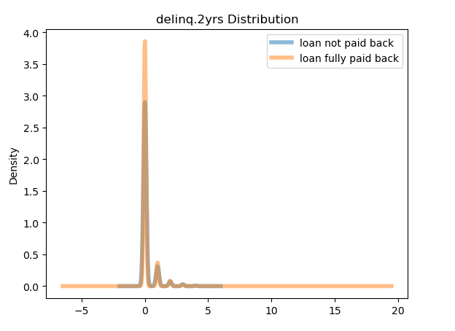
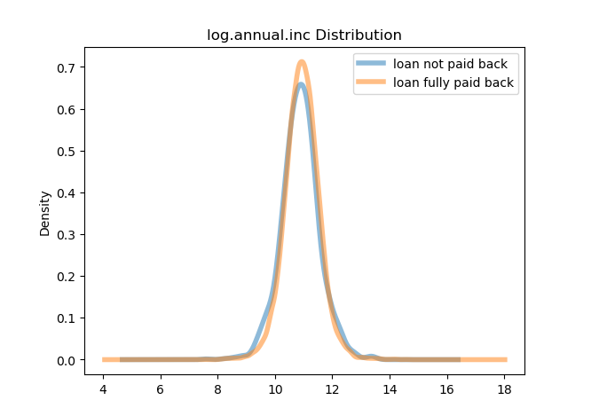
Outcomes: Lasso with Log Regression
Non zero variables (0.1 threshold):
int.rate
log.annual.inc
delinq.2yrs
And every
purpose column
Notes:
No overfitting, the variable int.rate was by far the most important variable, matches up with our next slides
Our data is real but the 2 distributions look so similar that it looks fake? Comparisons of real populations never look this close.

Slide 15
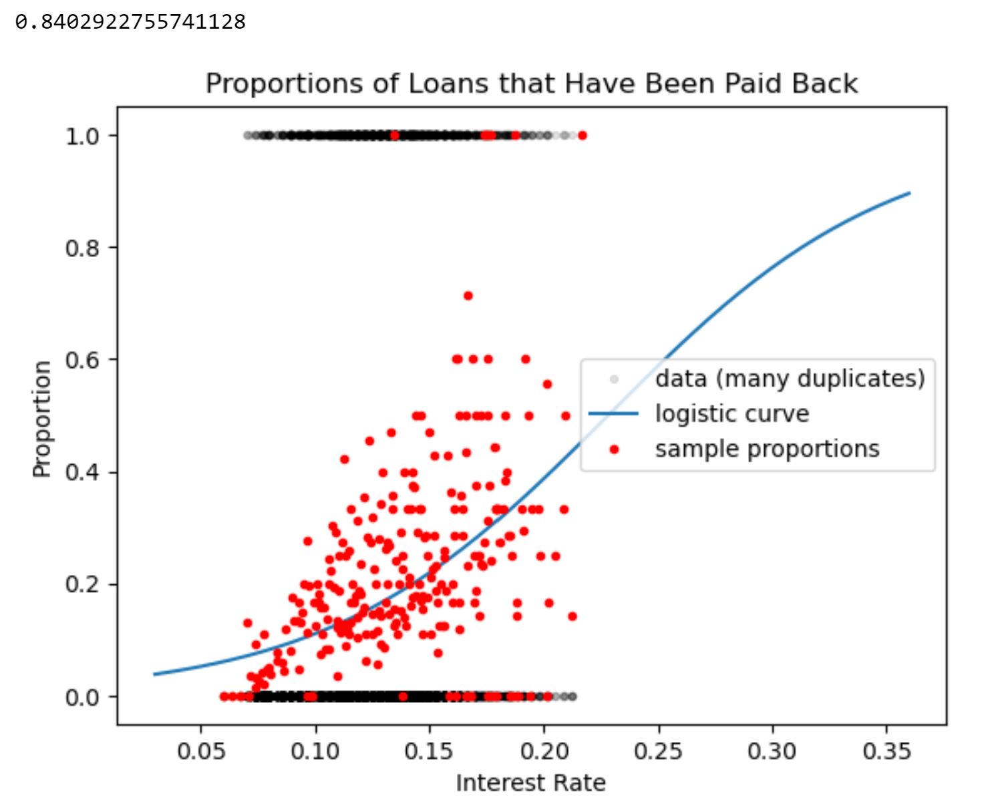
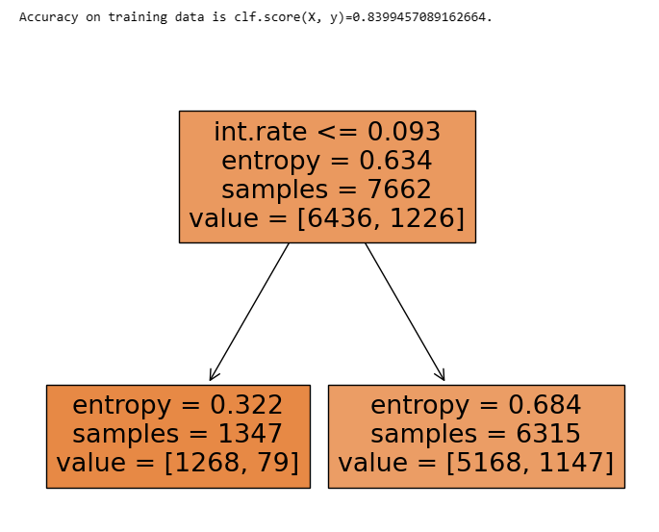
Decision Tree Plot
Logistic Regression Graph
Notes:
There's no clear interest rate, where it is clear that someone wouldn't pay back their loan.
Deep tree overfits but a shallow tree always predicts 0

Slide 16
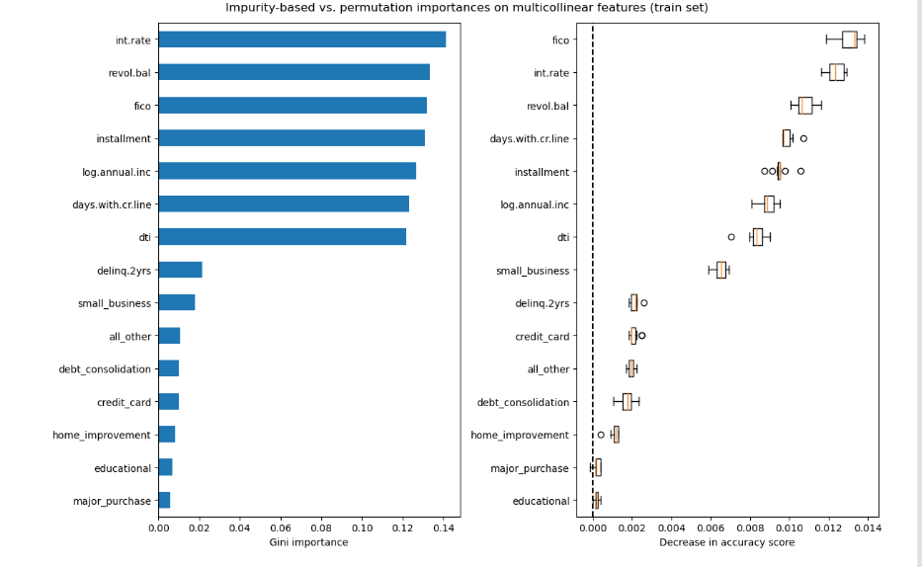
Random Forest Classifier Feature Importance
https://scikit-learn.org/stable/auto_examples/inspection/plot_permutation_importance_multicollinear.html#sphx-glr-auto-examples-inspection-plot-permutation-importance-multicollinear-py
Notes:
the impurity-based feature importance of random forests suffers from being computed on statistics derived from the training dataset: the importances can be high even for features that are not predictive of the target variable, as long as the model has the capacity to use them to overfit.

Slide 17
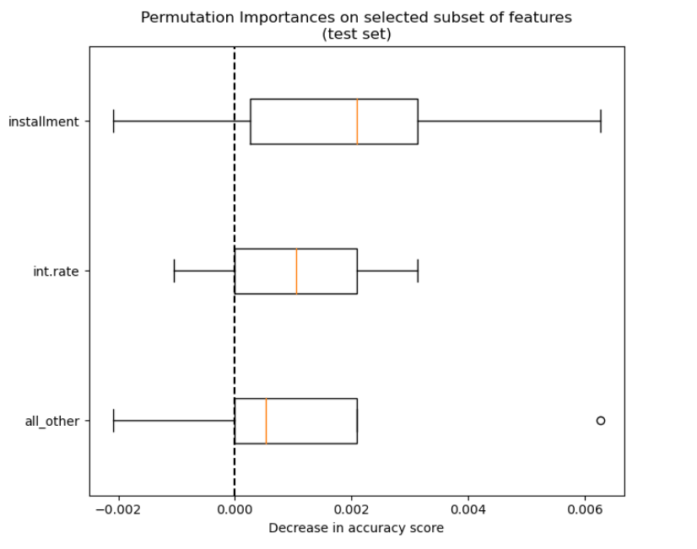
Random Forest Classifier Feature Importance
https://scikit-learn.org/stable/auto_examples/inspection/plot_permutation_importance_multicollinear.html#sphx-glr-auto-examples-inspection-plot-permutation-importance-multicollinear-py

Slide 18
Conclusion
Maybe predicting 0 is best until we find a variable that is more informative to correctly predict not paying a loan.
How could f1 score(combination of recall and precision) help evaluate the best model instead of accuracy?

